Slide 1
Exception Handling
By Kotha Harsha

Slide 2
Exception Handling:
Exception handling in Object oriented Programming is used to manage Errors.
In C# the Exceptions can be handled by the try-catch-finally keywords.
By doing so, you can handle exceptions gracefully, improving the reliability and robustness of your applications. Effective exception handling is an essential part of writing stable and user-friendly software, as it allows you to anticipate and handle errors that might occur during execution.
Try :A Try block is a block of code inside which an error can occur
Catch: When any error occur in Try block ,Then it is Passed to catch block to Handle it.
Finally: The Finally Block is used to to excute a given set of statements ,whether an exception is thrown or not thrown
Throw(Keyword):A Program throws an exception when a problem shows up.this is done using a throw keyword.
Inside the catch block you can use throw keyword to pass the stack trace to level up

Slide 3
Try-Catch Blocks for Exceptions:
Try-catch blocks are used to handle runtime exceptions, also known as logical errors or exceptional conditions.
Exceptions can occur due to issues like dividing by zero, accessing an array index out of bounds, or attempting to open a file that doesn't exist.
The try block contains the code where exceptions may occur, and the catch block is used to catch and handle those exceptions.
You use try-catch blocks to gracefully handle and recover from runtime errors, preventing your program from crashing.
Syntax Errors:
Syntax errors are detected by the compiler during the compilation phase.
These errors are related to the structure and grammar of the programming language, not to the program's logic or runtime execution.
Examples of syntax errors include missing semicolons, unmatched parentheses, or undeclared variables.
You must fix syntax errors in your source code before you can compile and run your program.
In summary, try-catch blocks are not used to handle syntax errors; they are used to handle exceptions or runtime errors. Syntax errors need to be resolved directly in your source code to successfully compile your program, and they are not related to the try-catch mechanism.

Slide 4
Exception Classes in C#
C# exceptions are represented by classes . The classes in C# are derived from the “System.Exception” class.
Some of the exception classes derived from the System.Exception class are the
1.System.ApplicationException (class supports exceptions generated by application programs. Hence the exceptions defined by the programmers should derive from this class.)
2.System.SystemException classes(The System.SystemException class is the base class for all predefined system exception)

Slide 5
Some of the predefined exception classes derived from the Sytem.SystemException class
System.IO.IOException
Handles I/O errors.
System.IndexOutOfRangeException
Handles errors generated when a method refers to an array index out of range.
System.ArrayTypeMismatchException
Handles errors generated when type is mismatched with the array type.
System.DivideByZeroException
Handles errors generated from dividing a dividend with zero.
System.OutOfMemoryException
Handles errors generated from insufficient free memory.
System.NullReferenceException
Handles errors generated from referencing a null object.
System.StackOverflowException
Handles errors generated from stack overflow.

Slide 6
Syntax
try
{
//write some code that can raise an exception
}
catch(someException)
{
//Handle the caught exception
}

Slide 7
Handling Exception (Example)
static void Main()
{
string s =Console.ReadLine();
try
{
Int32.Parse(s);
Console.WriteLine(“You entered valid Int32 number {0}.”,s);
}
catch (FormatException)
{
Console.WriteLine(“Invalid integer number!”);
}
catch(OverflowException)
{
Console.WriteLine(“The number is too big to fit in Int32!”);
}
}

Slide 8
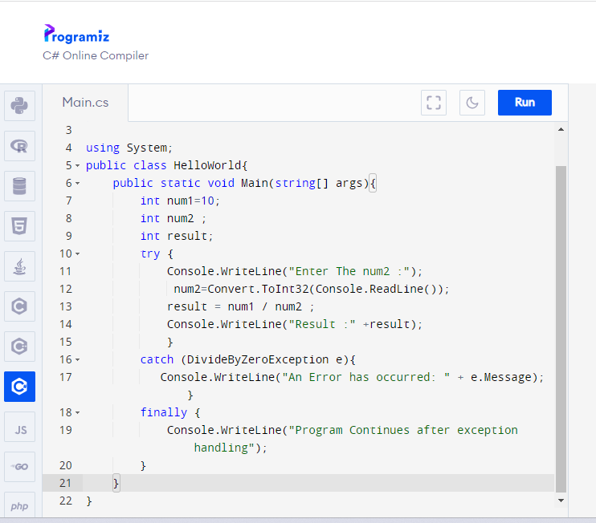

Slide 9
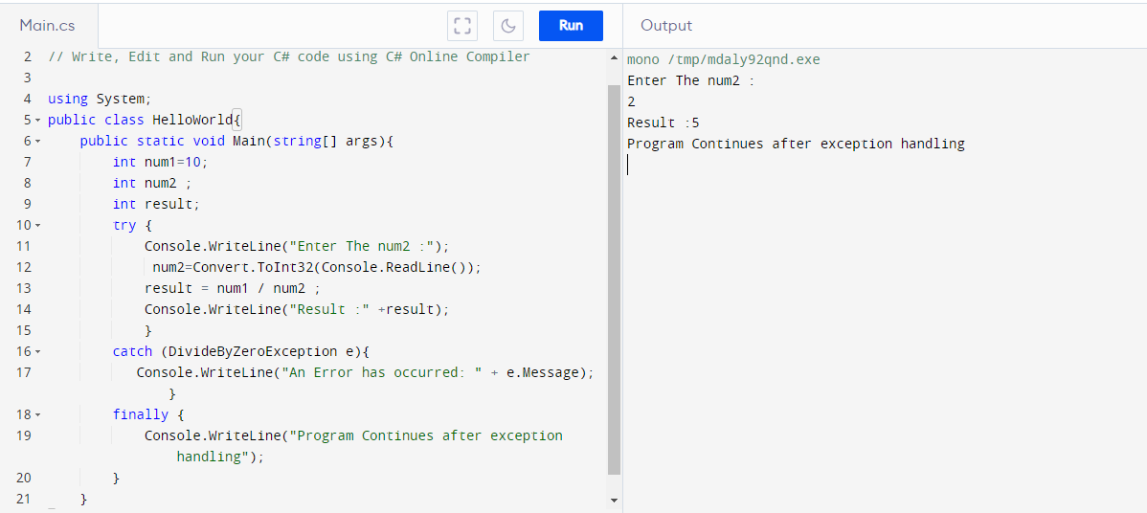

Slide 10
